Slide 1
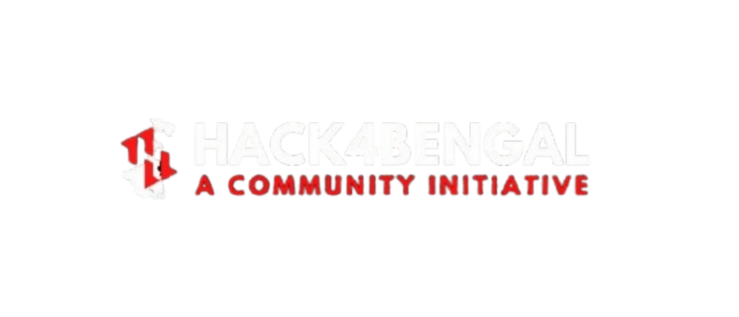
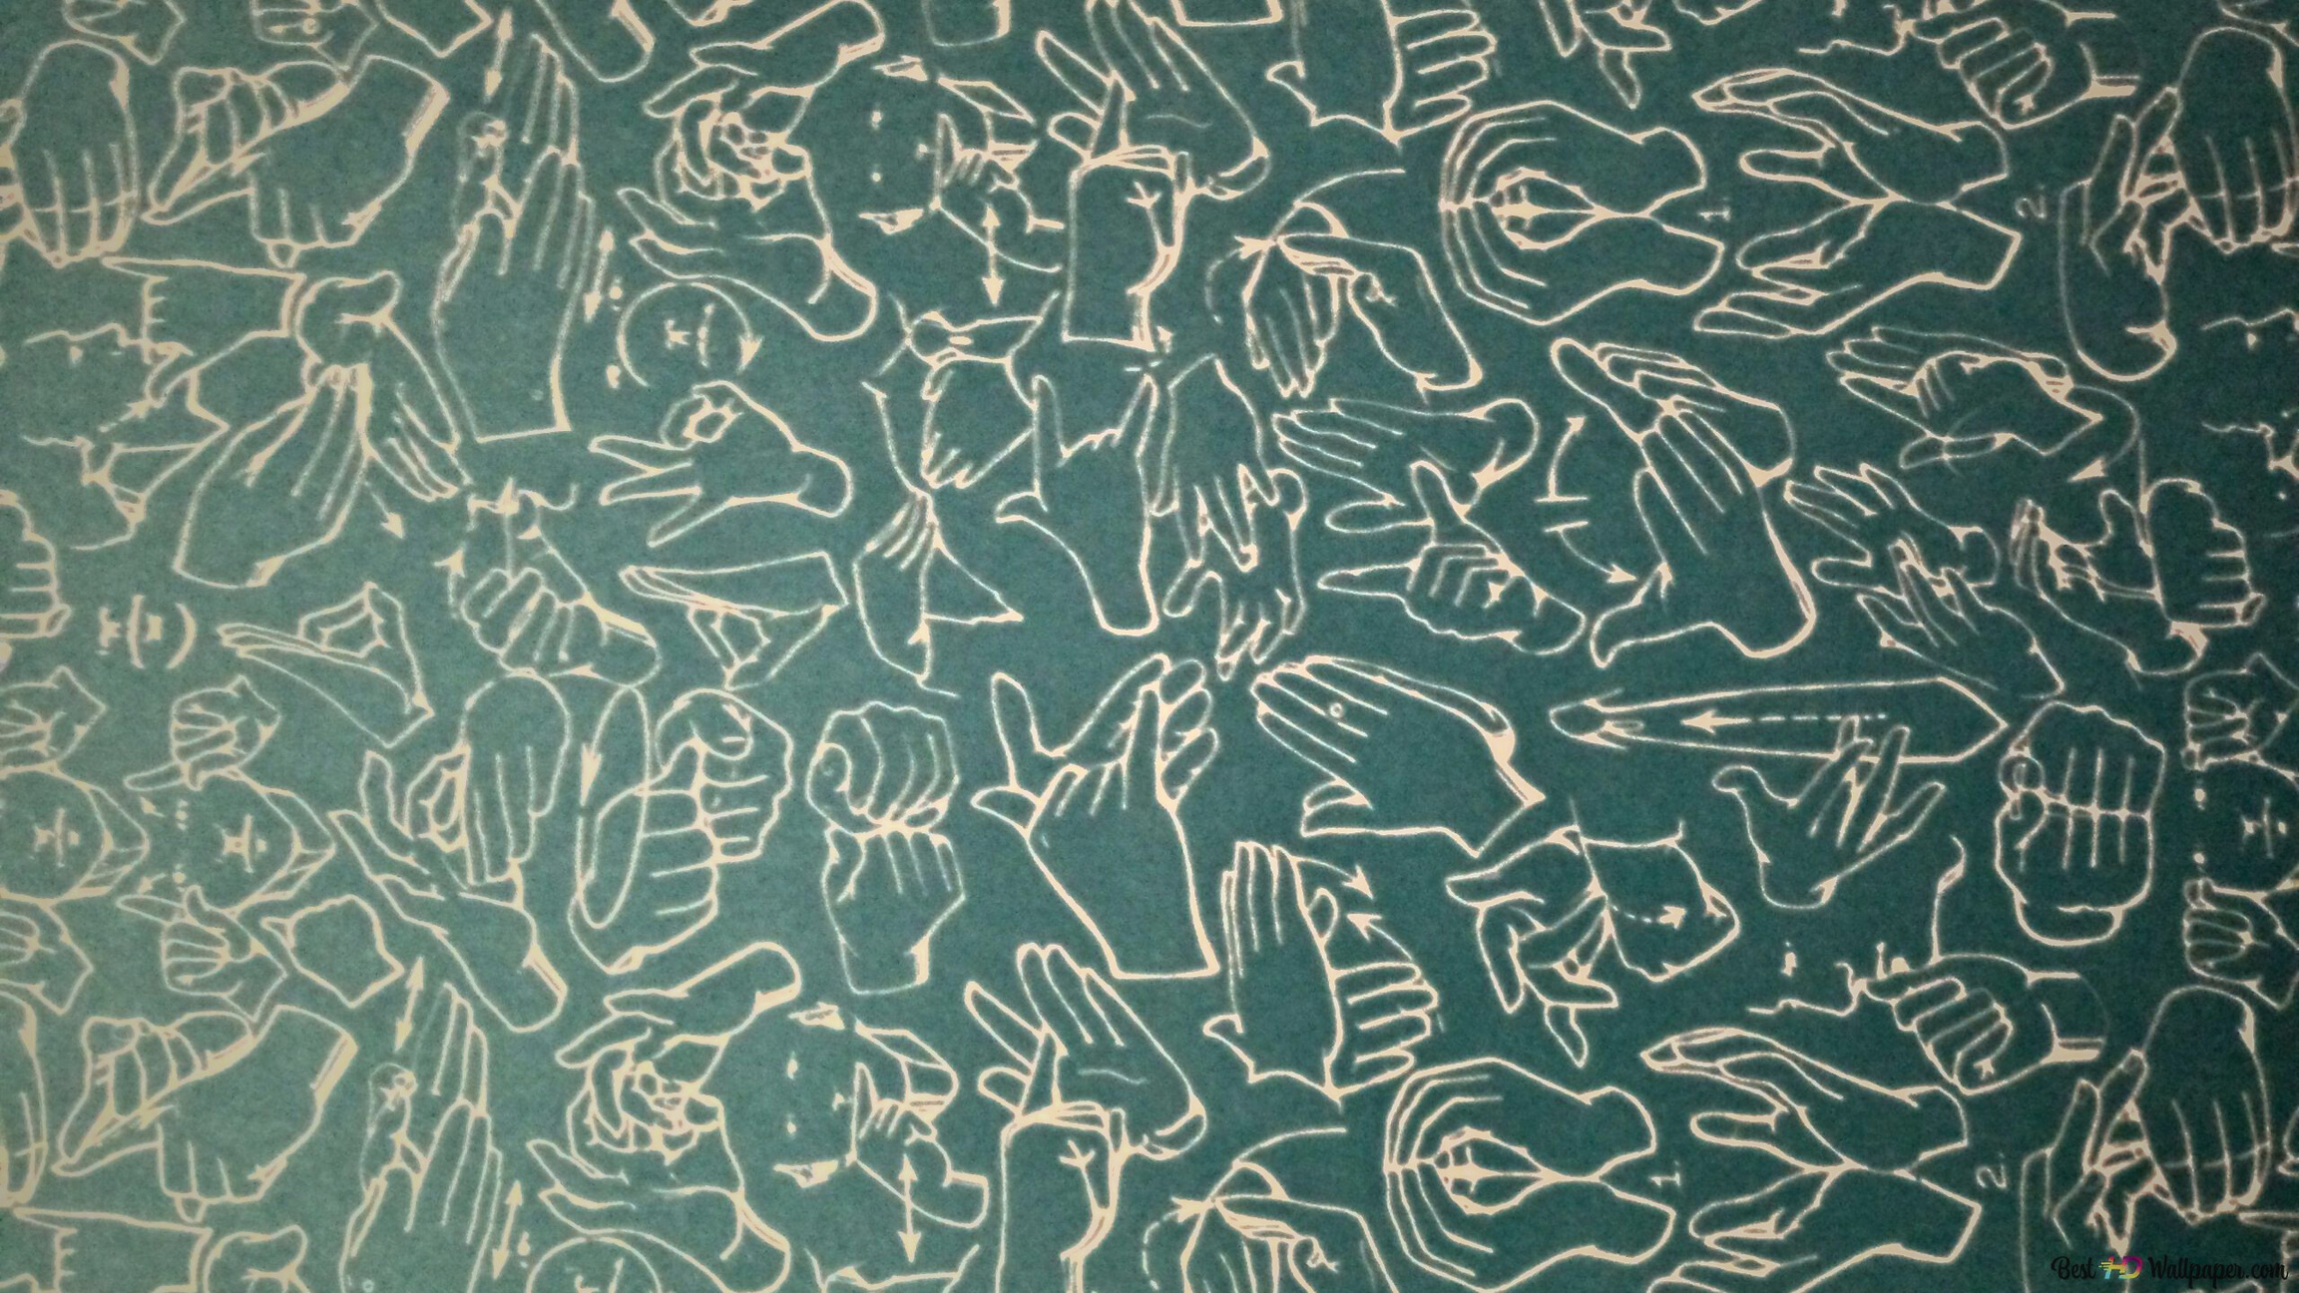
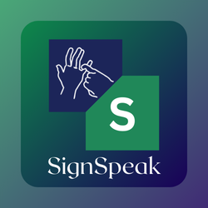



SignSpeak
THE FUTURE OF INEXCLUSIVE COMMUNICATION
PRESENTED BY- TEAM codeARC
CHIRAG NAHATA
SNIGDHA GHOSH
SRIJITA SAHA
RAJAT MITRA

Slide 2
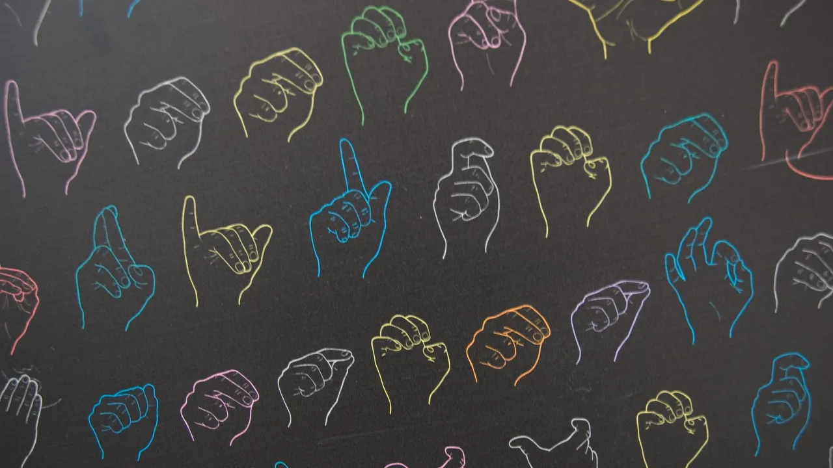


THE PROBLEM
THE COMMUNICATION GAP
PROBLEM 1
Over 70 million people worldwide rely on sign language
PROBLEM 2
Limited accessibility in public spaces, workplaces, classrooms
PROBLEM 3
Existing solutions lack fluidity, scalability, or real-time capability

Slide 3
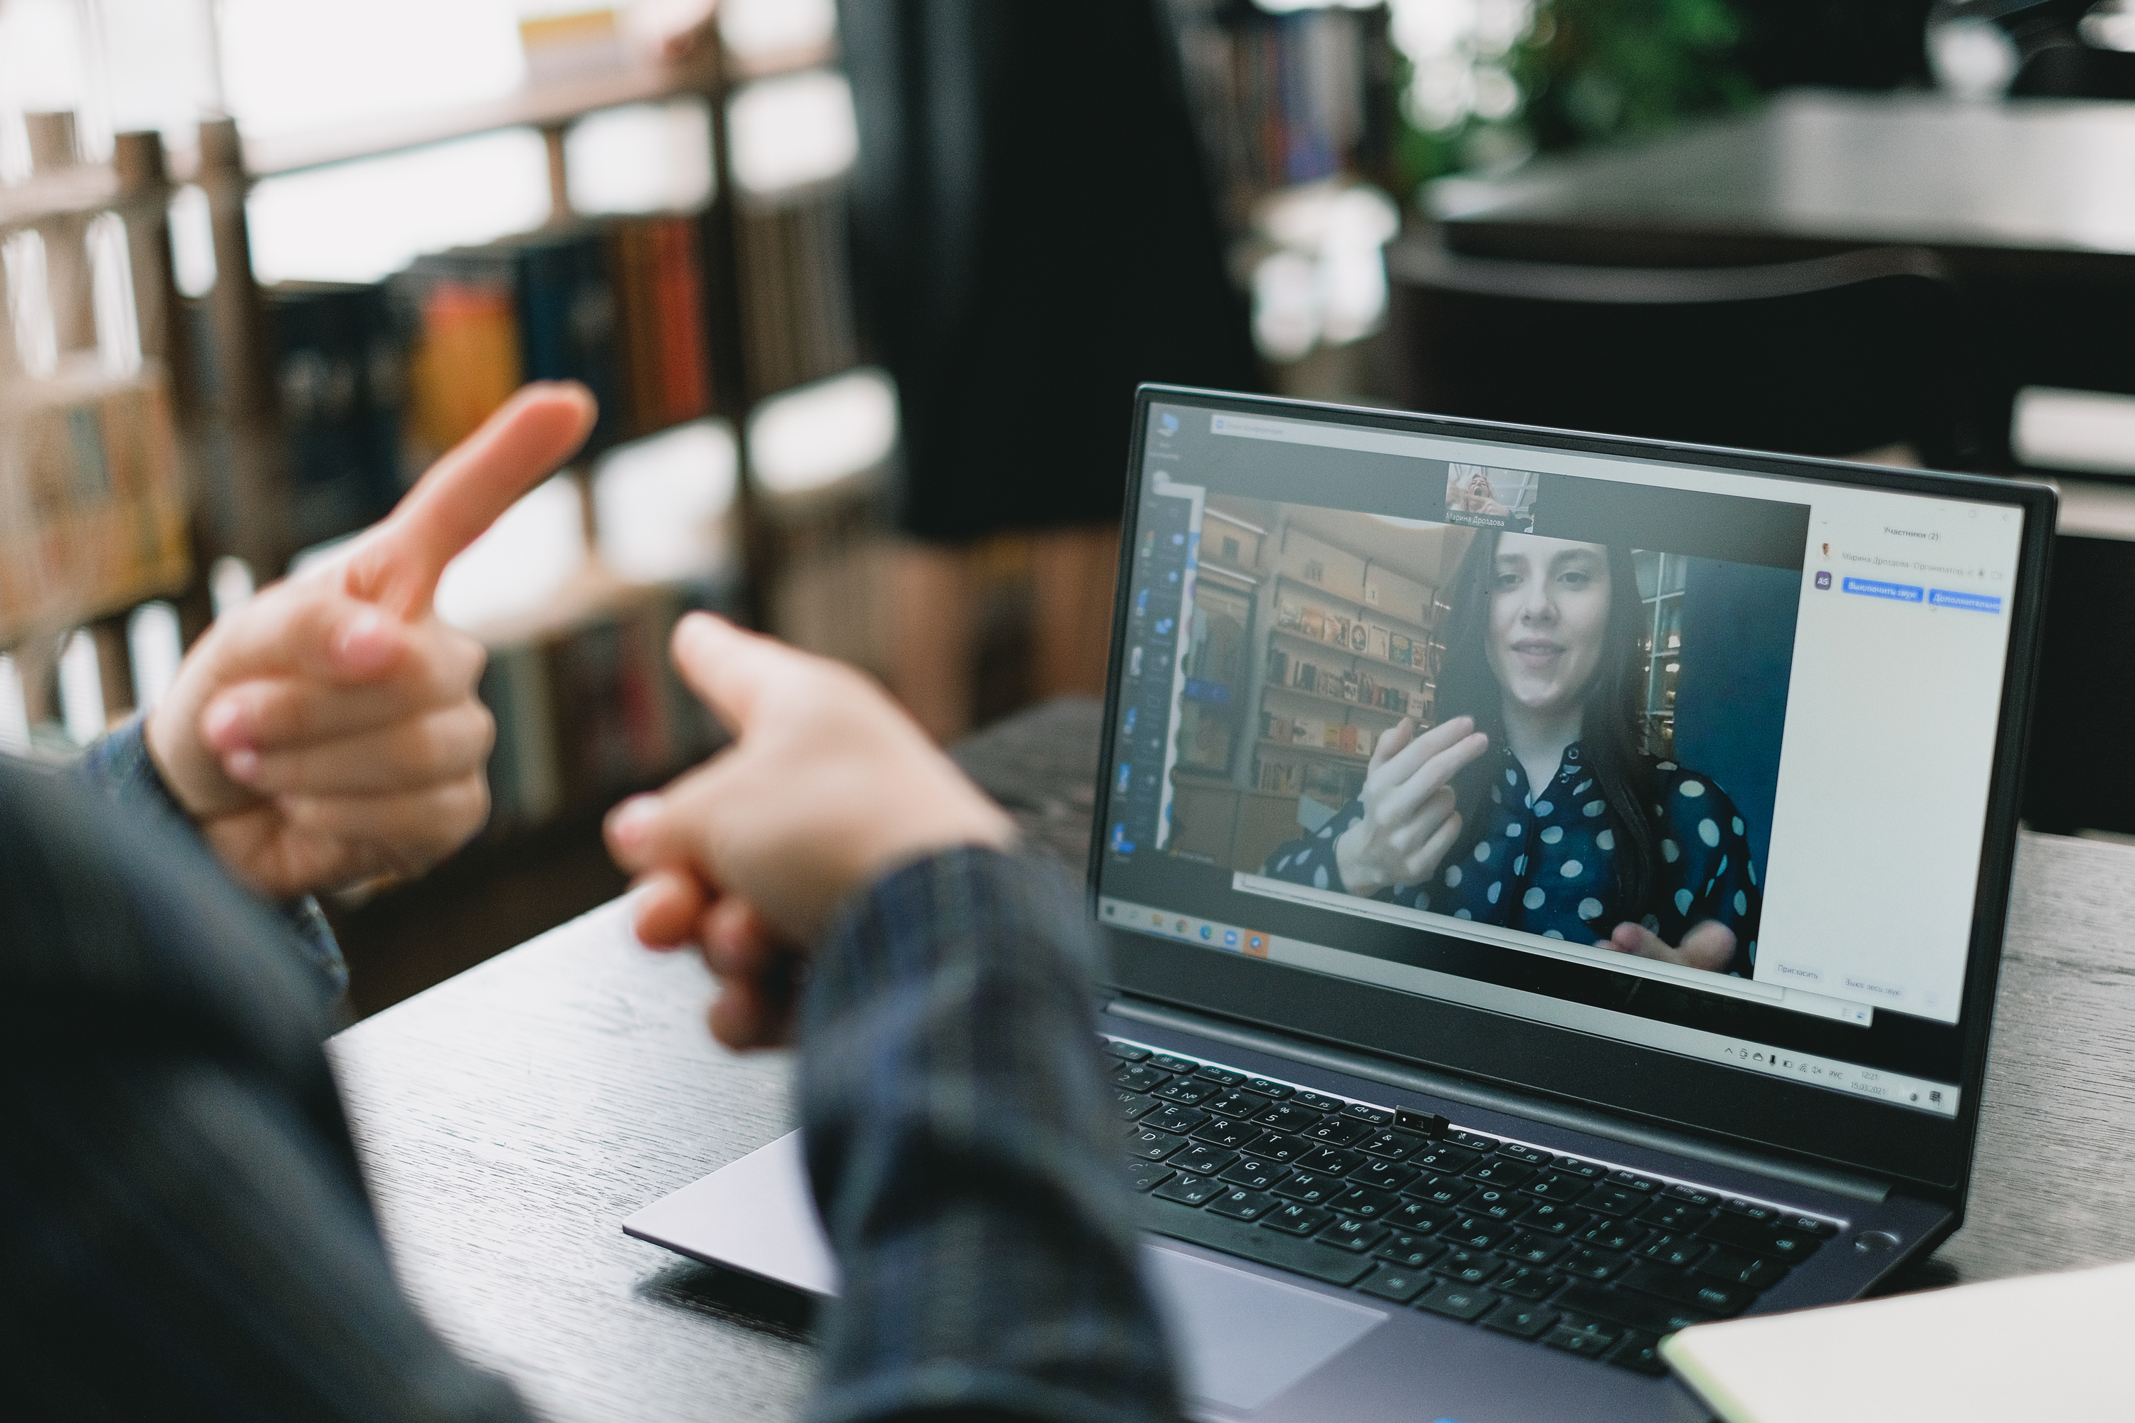
SOLUTION
Meet SignSpeak
AI-powered real-time sign-to-speech/text translator
Designed for accessibility, beauty, and global use
Seamless, fluent communication via webcam
Natural, human-like output with emotional context

Slide 4
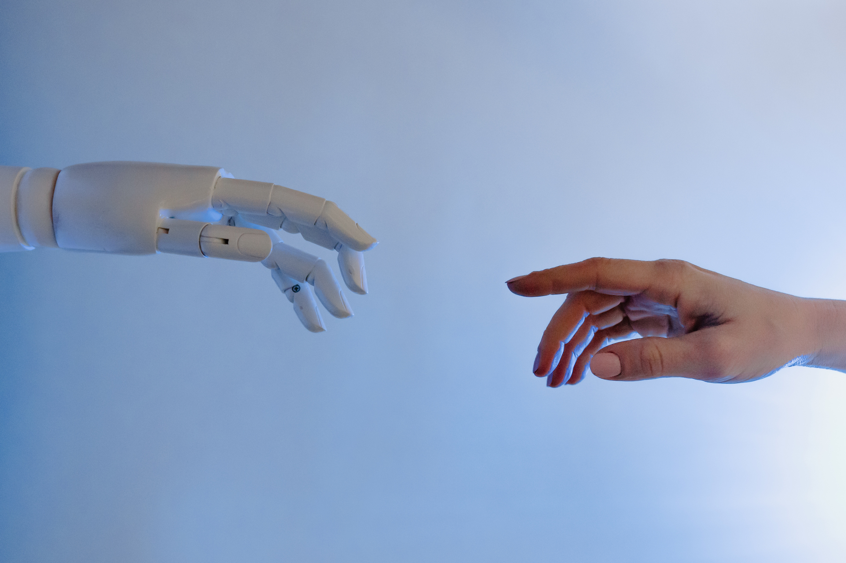
Real-time gesture recognition
Auto-correction + learning feedback
AI-generated natural language conversion
FEATURES
Accessibility-first UI
Multilingual TTS output
Customised voice
output

Slide 5




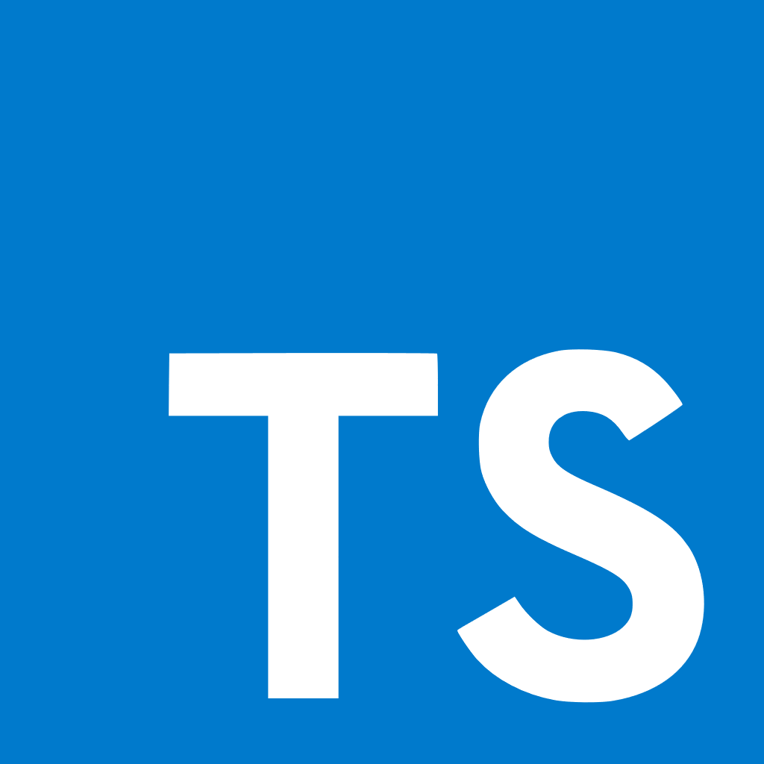






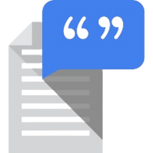

REACT + VITE + TAILWIND + TYPESCRIPT+ FRAMER MOTION
FRONTEND
FASTAPI + OPENCV + MEDIAPIPE +PYTHON
BACKEND
TECH STACK
ML MODEL+ GTTS
AI/NLP
CREATIVE IDEA
OTHERS
WEBSOCKETS

Slide 6

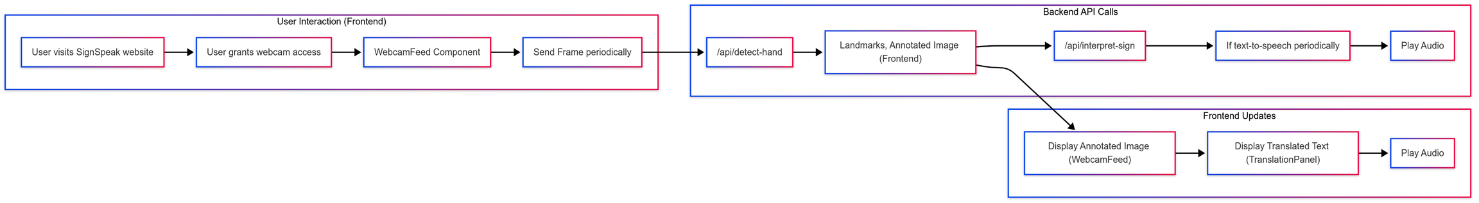
End-to-End System Flowchart
This flowchart illustrates the seamless pipeline of SignSpeak — from capturing hand gestures via webcam, processing them through AI-based gesture recognition, enhancing with natural language generation, and finally delivering multilingual speech and text outputs. Real-time feedback and accessibility modules make this a complete assistive solution.

Slide 7
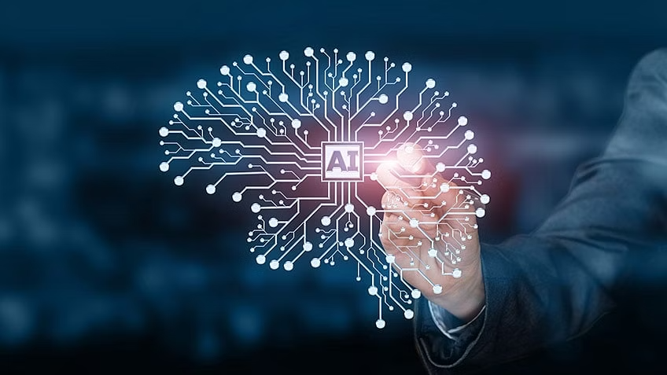







Custom-trained AI model for real-time sign recognition
Most feature-rich sign platform in a hackathon
WHY SignSpeak STANDS
OUT?
Ultra-modern + accessibility-centric design
Ready for real-world use in schools, hospitals, public spaces
Future-ready architecture (avatars, AR, offline, multilingual NLP)

Slide 8
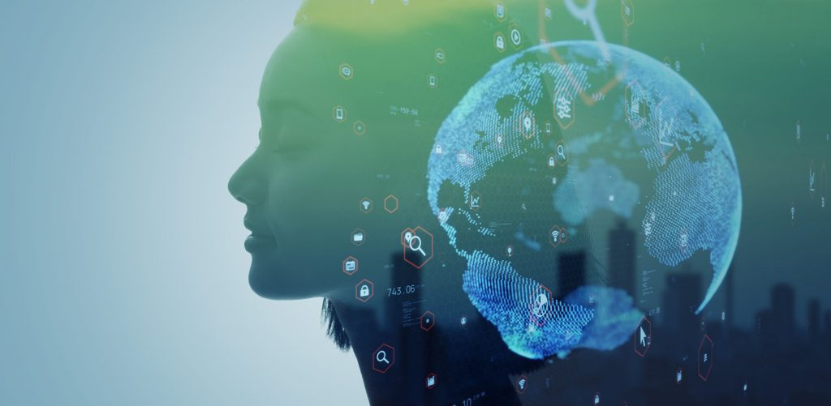
REAL WORLD IMPACT
01
02
03
04
Enables millions with hearing/
speech impairments
From hackathon to deployment in real sectors
Inclusive communication for everyone, everywhere
Breaking tech barriers with empathy

Slide 9



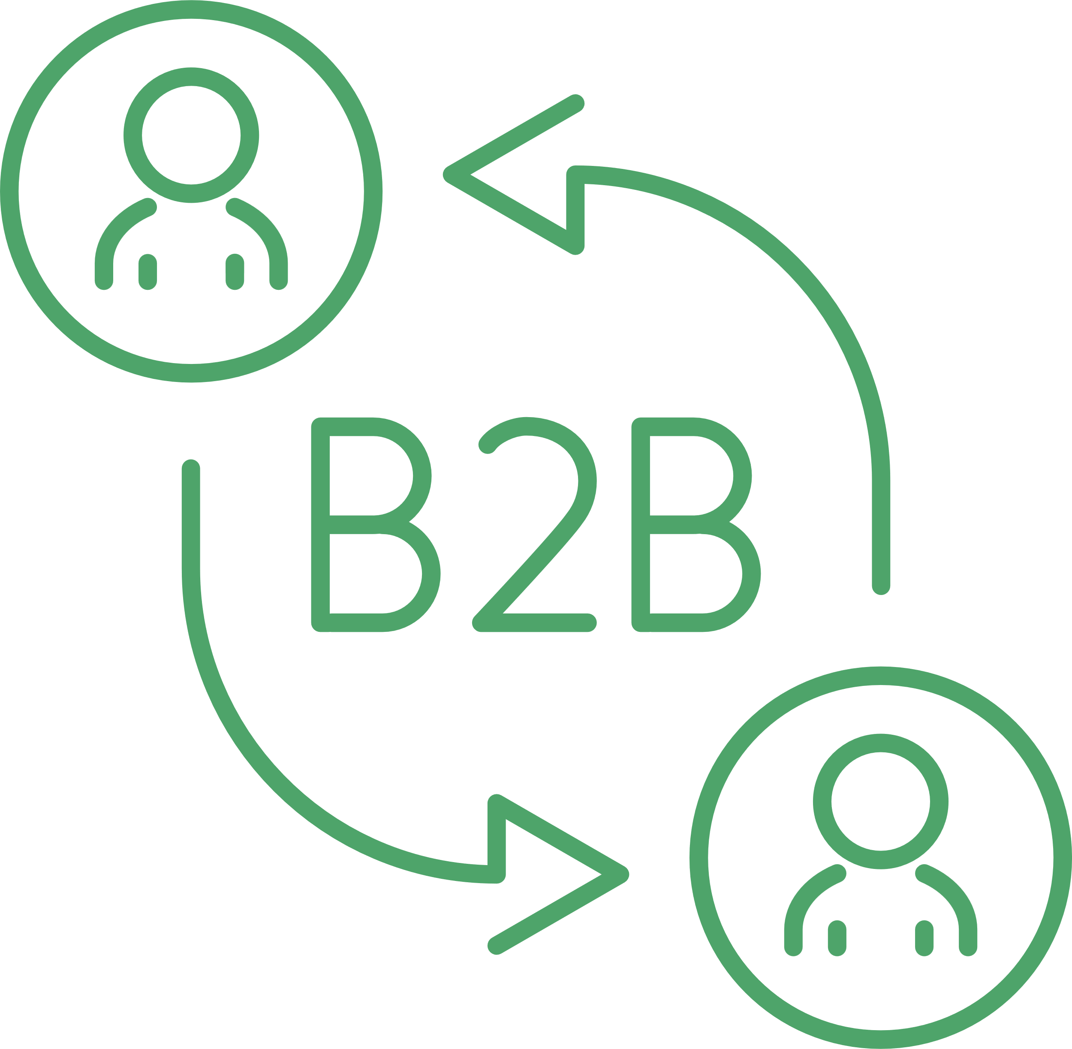


BUSINESS APPROACH
TARGET MARKET
FREEMIUM MODEL
B2B PARTNERSHIPS
GRANTS & CSR FUNDING
FUTURE SAAS MODEL
Educational institutions, hospitals, government sectors, and public service environments
Basic real-time translation for free; premium features like multilingual support and avatars for a fee
Collaborate with NGOs, EdTechs, and assistive tech companies
Tap into accessibility innovation grants and corporate social responsibility initiatives
Subscription-based API for integration into 3rd party platforms

Slide 10

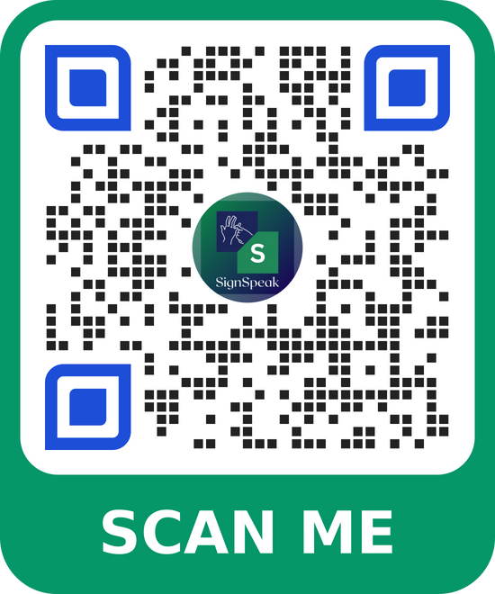
THANK YOU

